Slide 1
Flask FrameWork & RestAPI

Slide 2
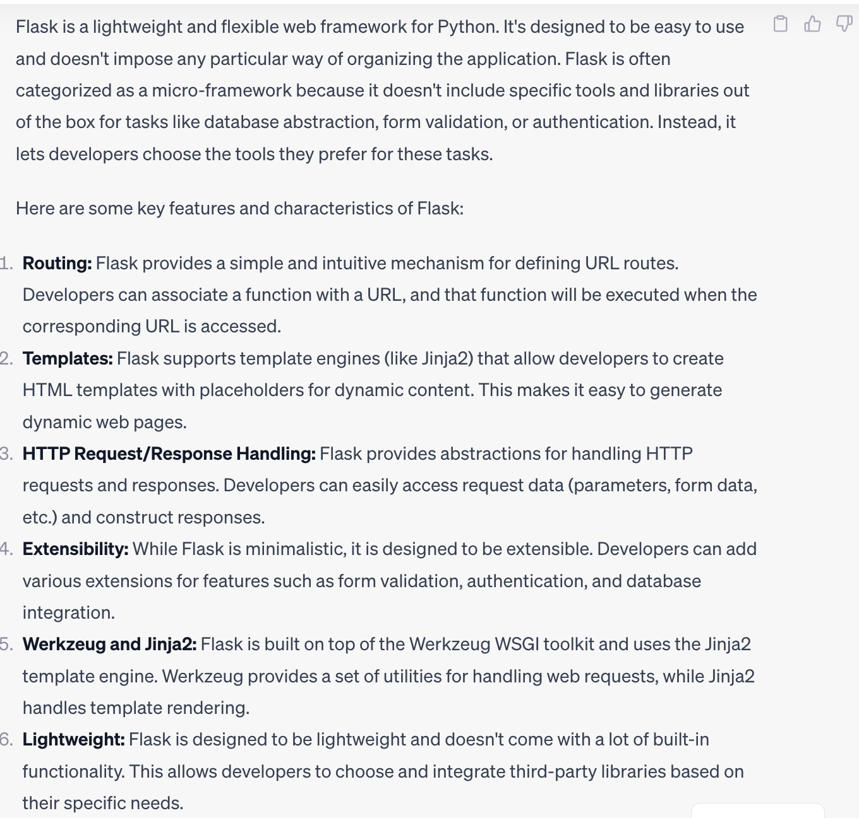
Flask Framework Definition

Slide 3
How to Install Flask
Go to Terminal
ls → Check all List
cd Documents → Going to Directory
mkdir filename → Create a file
Install Flask (create virtual environment & activate flask)
https://flask.palletsprojects.com/en/3.0.x/installation/
Read/Write access command
sudo chmod -R a+rwx

Slide 4
How to run Flask
Go to Terminal
python3 filename
To Quit
Ctrl + C
Go back one step
cd ..
Need to activate every time (flask) after you quit
Testing from command line
curl http:/ (ip address)

Slide 5
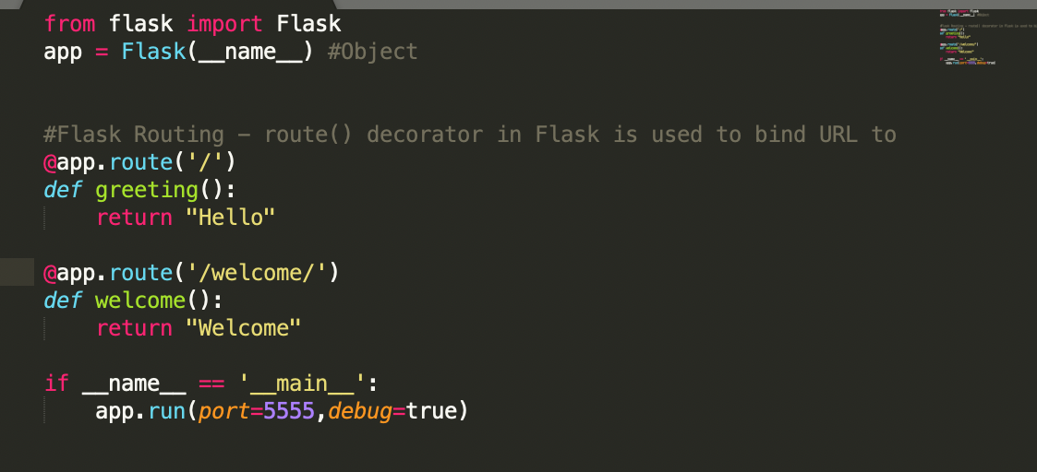
Flask Basic & Routing

Slide 6
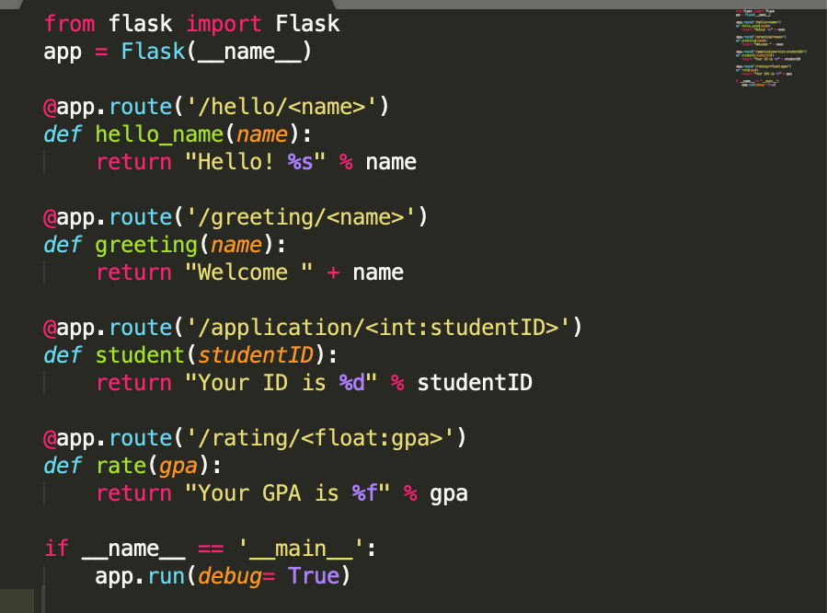
Flask Variable

Slide 7
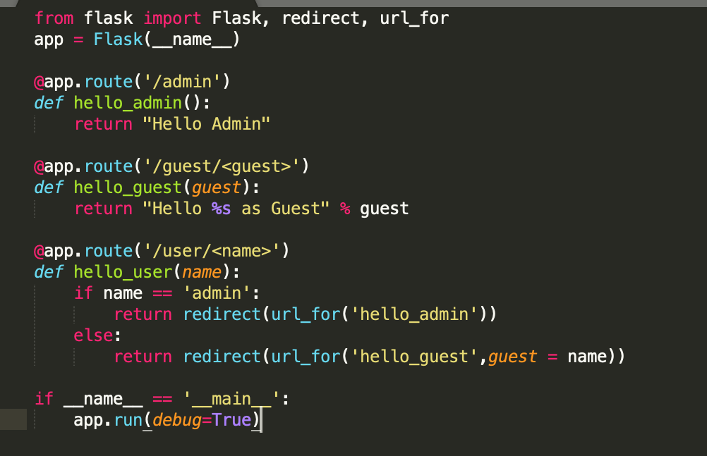
Flask URL

Slide 8
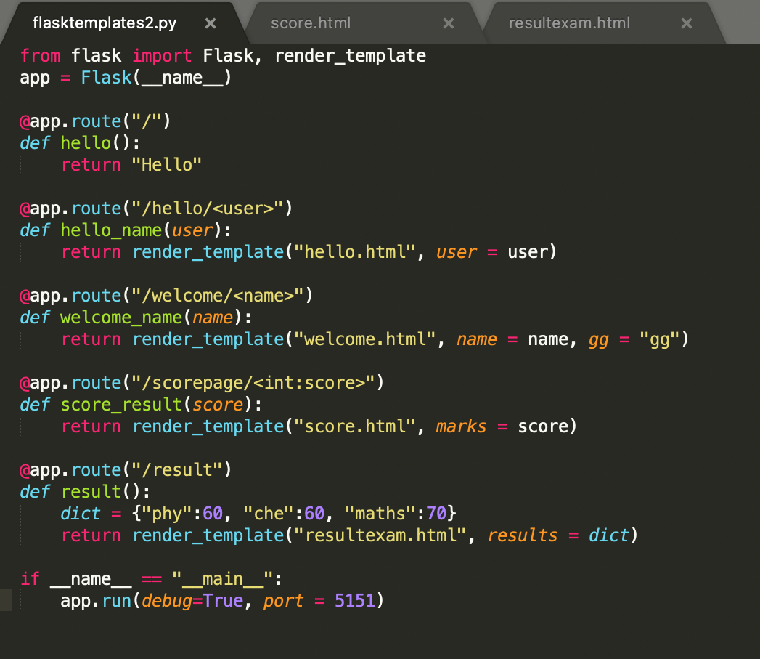
Flask Templates

Slide 9
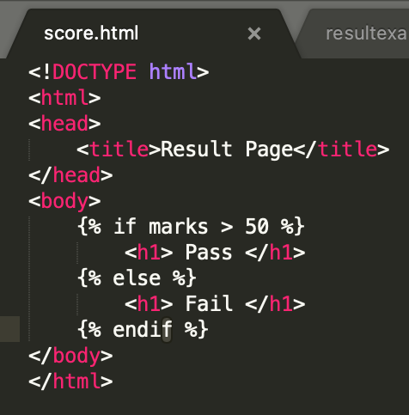
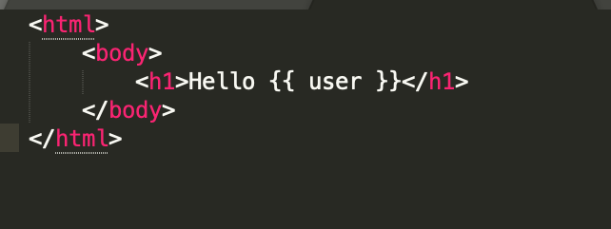
Flask Templates

Slide 10
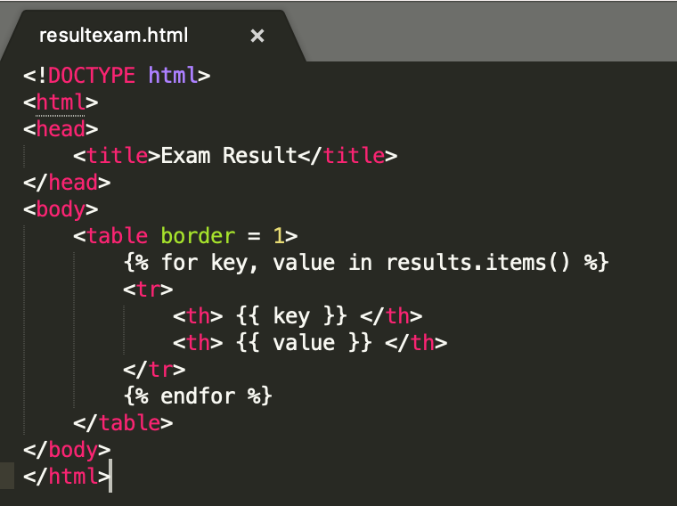
Flask Templates

Slide 11
Rest API

